Slide 1
Students Loan
Let’s look at
How much has been borrowed,
and how many students have taken out loans?

Slide 2
2007 - 2022
01
Total Dollars vs Recipients
Direct Loan, Federal Femily Education Loan, Perkin
Overview

Slide 3

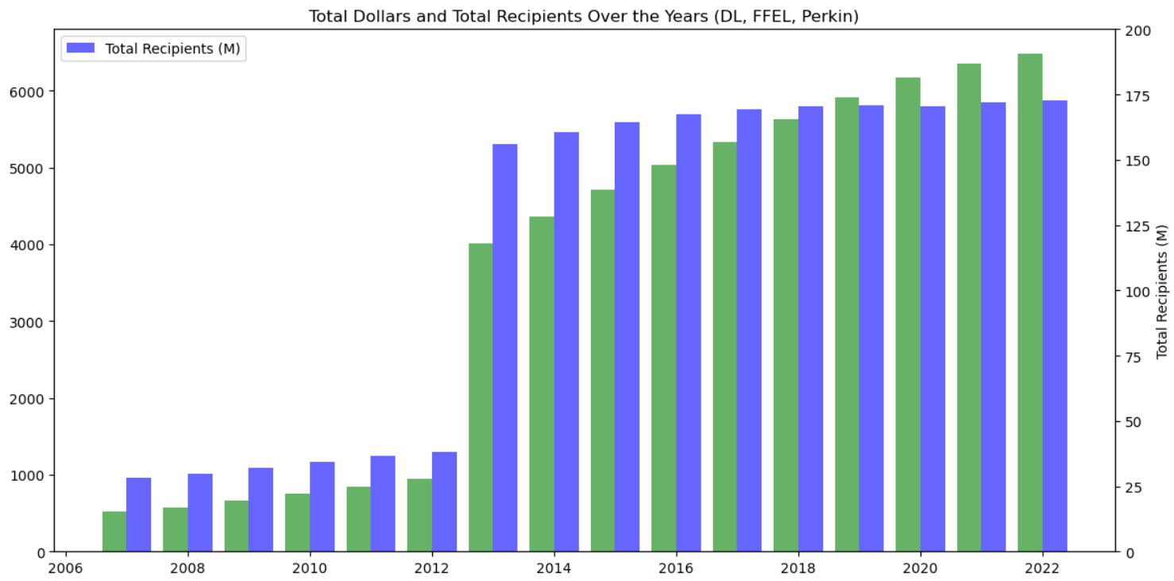
This bar graph presents a comparison between total dollar amounts and the number of recipients from the years 2007 to 2022.
A significant increase is evident in 2013, with the number of recipients surging to more than three times the previous year's figure.
Notably, from 2007 up until 2019, the funds available did not suffice to cater to all students

Slide 4
2007 - 2022
02
Recipients Over the Years
Direct Loan, Federal Femily Education Loan, Perkin
Overview

Slide 5
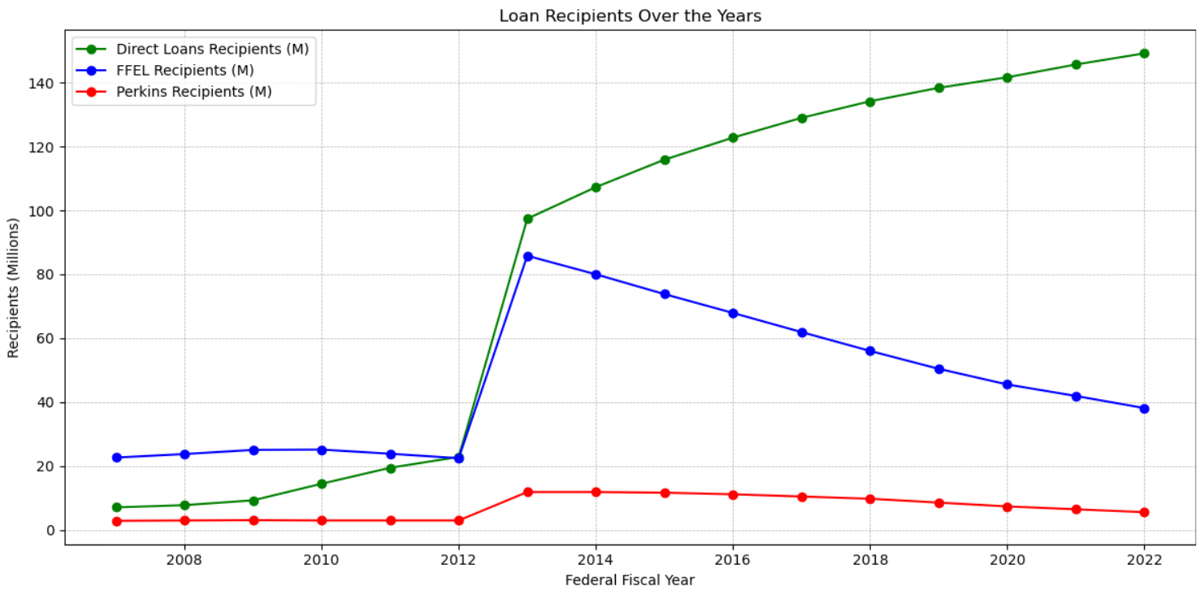
A consistent increase in Direct Loans recipients from 2008 to 2022, with a sharp rise between 2012 and 2014.
FFEL recipients peaked in 2014 but dwindled by 2022, indicating changing borrowing trends.
Perkins loan recipients showed minor fluctuations, suggesting consistent demand and funding over the years.

Slide 6
2007 - 2022
03
The Distributions
Direct Loan, Federal Femily Education Loan, Perkin
Overview

Slide 7
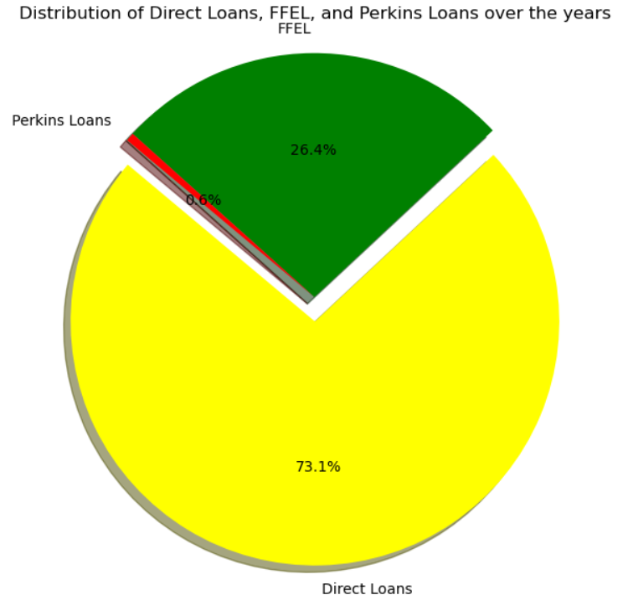
Direct Loans constitute a substantial 73.1% of the total.
FFEL loans account for 26.4%, showing significant but lesser adoption.
Perkins Loans represent a minimal 0.6% of the distribution.

Slide 8
THANK YOU

